Slide 1
Capstone Project 1
EDA on Hotel Booking By Tushar Gautam

Slide 2

What is EDA EDA stands for Exploratory Data Analysis. EDA is an approach to analyse the data using visual techniques. It is used to discover various trends, patterns or to check the assumtptions using statistical summary and graphical representation.

Slide 3
Dataset
The data set contains booking information for a city hotel and a resort hotel, and includes information such as when the booking was made, length of stay, the number of adults, children, and/or babies, and the number of available parking spaces, among other things.
There are total of 119390 entries.
Total of 32 columns.

Slide 4
Data descrition
1) hotel : Hotel type.
2) is_canceled : value indicates if the booking is canceled or not.
3) lead_time : How long in advance the booking was made.
4) arrival_date_year : Customer arrival year.
5) arrival_date_month : In which month of the year customer visited hotel.
6) arrival_date_week_number : In which week of the year customer arrived.
7) arrival_date_day_of_month : Date of the month customer visited hotel.
8) stays_in_weekend_nights : Customer stayed or booked to stay in hotel during weekend nights.
9) stays_in_week_nights : Customer stayed in hotel during week nights.
10) adults : Number of adults
11) children : number of children.
12) babies : Number of babies.
13) meal : Type of meal booked.:
14) country : Country of orgin of cutomer.
15) market_segment : where the bookings came from.

Slide 5
16) distribution_channel : Booking distribution channel. The term “TA” means “Travel Agents” and “TO” means “Tour Operators” .
17) is_repeated_guest : Value indicating if the booking name was from a repeated guest (1) or not (0).
18) previous_cancellations : Number of previous bookings that were cancelled by the customer prior to the current booking.
19) previous_bookings_not_canceled : umber of previous bookings that were cancelled by the customer prior to the current booking.
20) reserved_room_type : Code of room type reserved. Code is presented instead of designation for anonymity reasons.
21) assigned_room_type : Code for the type of room assigned to the booking. Sometimes the assigned room type differs from the reserved room type due.
22) booking_changes : Number of changes/amendments made to the booking from the moment the booking was entered on the PMS.
23) deposit_type : Indication on if the customer made a deposit to guarantee the booking.

Slide 6
24) agent : ID of the travel agency that made the booking.
25) company : ID of the company/entity that made the booking or responsible for paying the booking.
26) days_in_waiting_list : Number of days the booking was in the waiting list before it was confirmed to the customer.
27) customer_type : Type of booking, assuming one of four categories.
28) adr : Average Daily Rate as defined by dividing the sum of all lodging transactions by the total number of staying nights.
29) required_car_parking_spaces : Number of car parking spaces required by the customer.
30) total_of_special_requests : Number of special requests made by the customer (e.g. twin bed or high floor).
31) reservation_status : Reservation last status, assuming one of three categories: Canceled – booking was canceled by the customer; Check-Out: customer check out from hotel,No show: Customer did not check-in hotel and informed hotel with reason.
32) reservation_status_date : Date at which the last status was set. This variable can be used in conjunction with the ReservationStatus to understand when was the booking cancelled or when did the customer checked out of the hotel

Slide 7
Data Cleaning
Data cleaning is the important steps in any EDA process as well as it is the most time consuming process in the entire EDA.
Data cleaning includes various steps :
Handling Missing Values.
Removing Duplicate Values.
Converting Columns to proper dtype format.
Adding or Removing some columns for analysis.

Slide 8
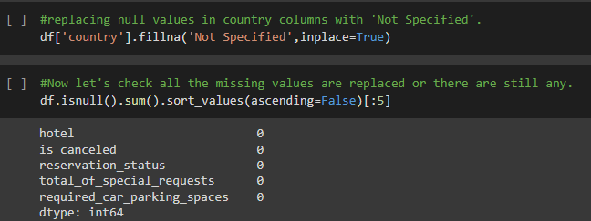
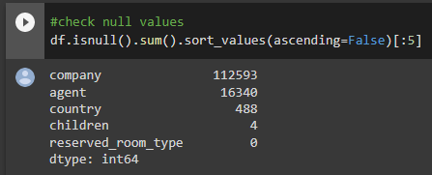
Handling missing values :
Checking missing values
Replacing Null Values

Slide 9
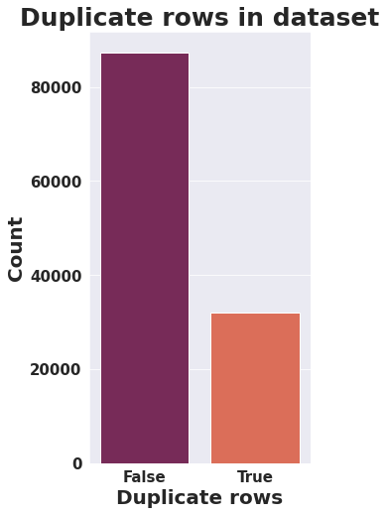
Removing Duplicates
-We have 119390 entries within 32 columns
-We are using true as a duplicate data
-We have 31994 duplicate data from total of
119390 rows.
Removing Duplicates

Slide 10
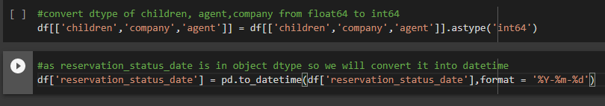
Converting dtype and format
Children, company and agent are in the form of numbers in the data but there dtype is given in float.
Converting format of date into datetime instead of object.

Slide 11
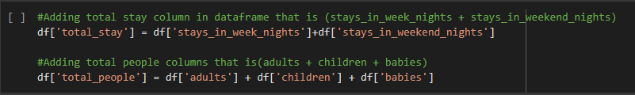
Adding Columns
-Adding total stay column in dataframe that is (stays_in_week_nights + stays_in_weekend_nights)
-Adding total people columns that is(adults + children + babies)

Slide 12
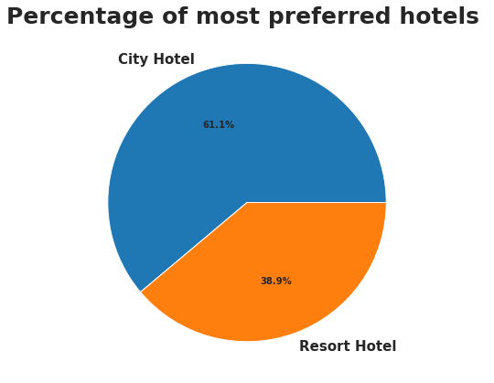
Exploratory data Analysis
Let’s check which hotel is mostly preferred by the customers
City hotels are more preferred
by guest as city hotels are mostly near by
Airports, Railway stations
Resort are situated at longer distance.

Slide 13
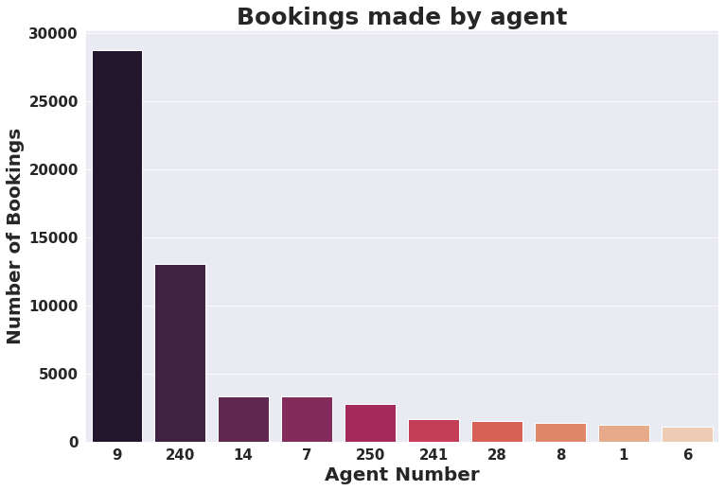
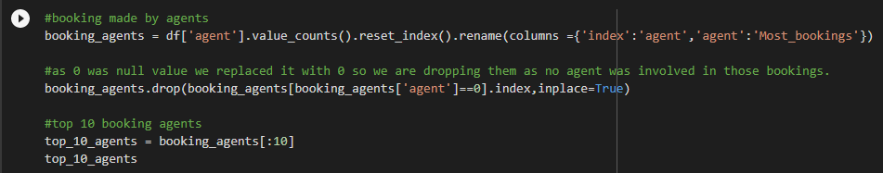
Which agent has made most booking
Id Number 9 agent has made most numbers
of bookings 28759.
Id Number 240 has most number of bookings
after ID 9 followed by 14 and 7.

Slide 14
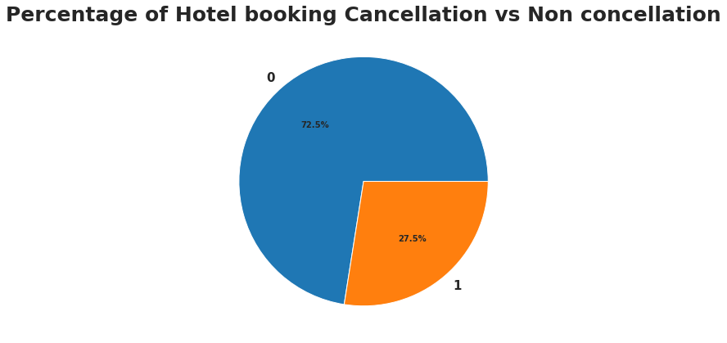
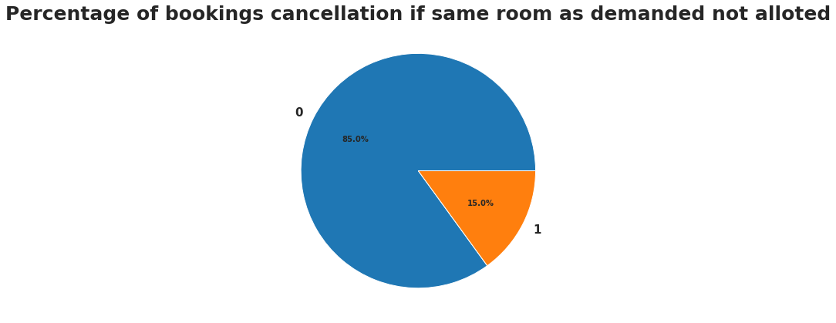
Percentage of booking cancellation and Does not getting same room type as demanded really causes cancellation?
-Here 0 defines as
Not cancelled and 1 for
Cancelled
-Only 15 % of bookings
were cancelled if not
alloted same room type
as demanded.

Slide 15
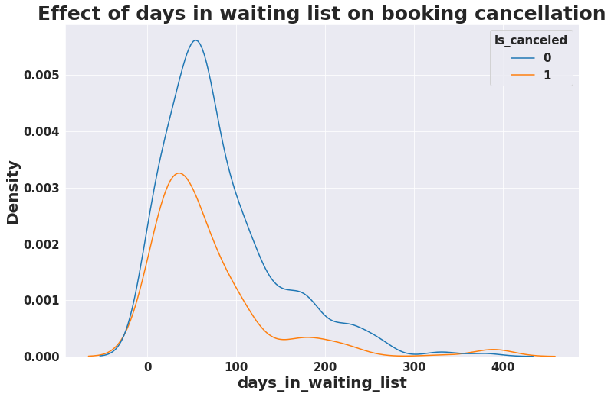
Does longer waiting period causes booking cancellation ?
We can see that most bookings were cancelled which has less than 100 days in waiting list but also bookings were not cancelled for the same still density of cancelled is slightly higher for the same but there is no direct effect of longer waiting period with booking cancellation.

Slide 16
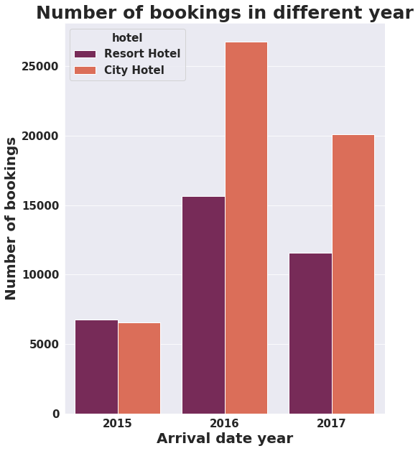
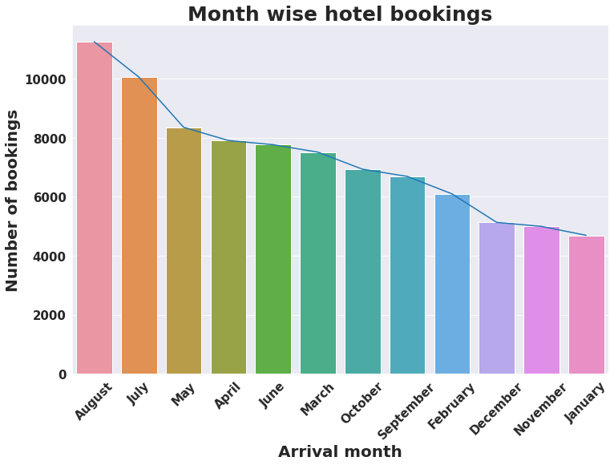
Which year and month has the highest bookings?
Year 2016 has the highest number of
bookings (42391) followed by 2017 (31692)
and 2015 (13313).
It seems that august has the highest
number of bookings

Slide 17
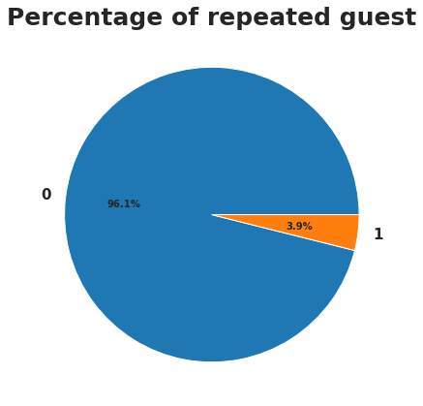
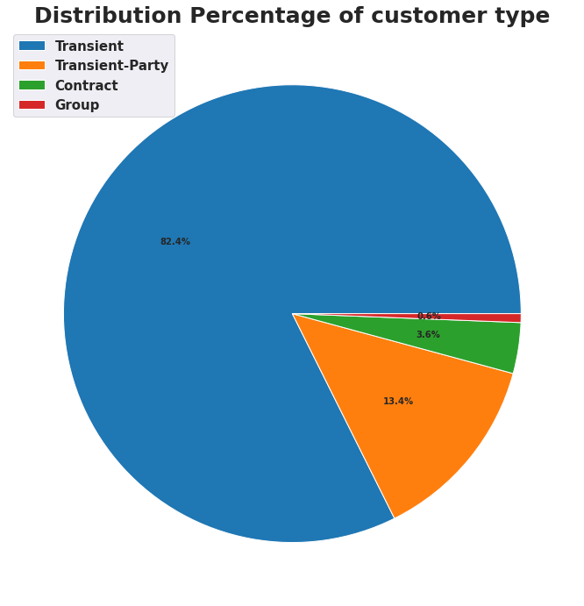
What is the percentage of repeated guest and customer type ?
It shows that only 3.9% guests are
repeated.
Transient has the highest distribution
percentage of customer type (82.4%)
and least 0.6% associated with Group
customer type.

Slide 18
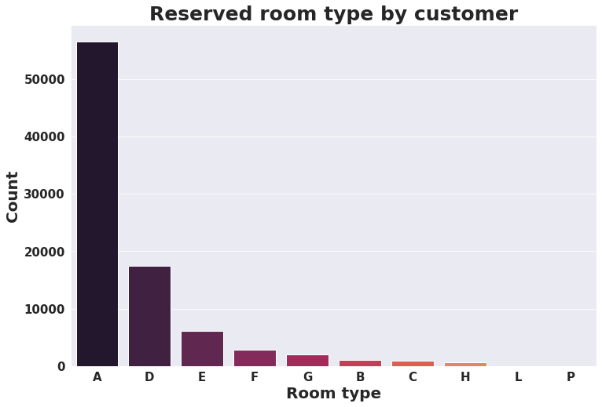
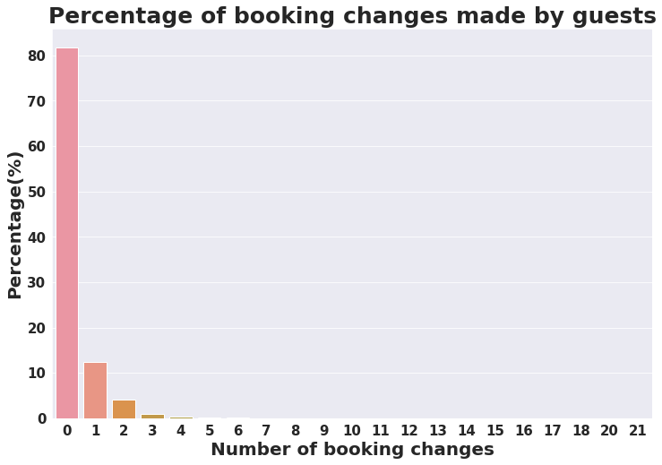
Percentage for changing made by guest and most reserved room type
More than 82% of bookings were not changed.
Around 12% of guest changed 1 booking and less
than 5% has made 2
Most reserved room type is A.
Least preferred are L and P.

Slide 19
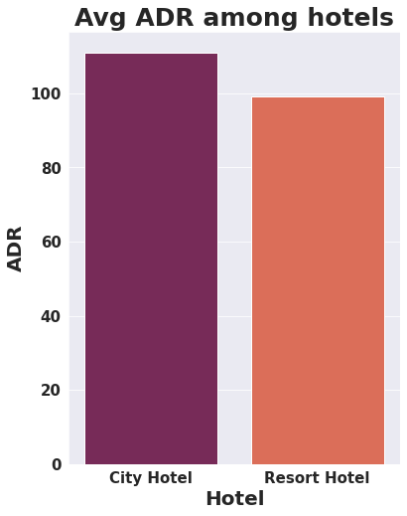
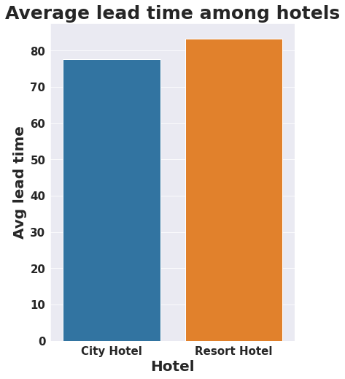
Which hotel type has more ADR and lead time
City hotels has the slightly highest ADR that means city hotels are genrating more revenue as compared to resort hotels.
Resort hotels has slightly high average lead time that means customer plans trip early than city hotels.

Slide 20
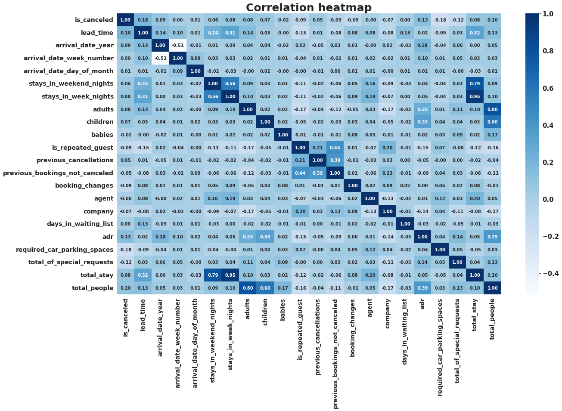
Correlation Heatmap
Total_stay and lead time have slight correlation
it. This might means that customer plan
reservation before their actual arrival.
Adr(Average Daily Rate) is slightly correlated
with total people, which makes sense as more
number of people means more revenue.
Previous booking not cancelled and repeated
guest have high correlation as repeated guest
are most likely to be who has not cancelled their
previous bookings.
We can also see that some columns have high
correlation between them for example total
people with adult and children it is because as
those column are dervied from them by addition.

Slide 21
Challenges
• Handling null values and finding a way to replace them with something
meaningful so that it doesn’t affect analysis.
• Choosing visualization for different analysis.

Slide 22
Conclusion
-City hotels are mostly preferred by guests they occupy 61.1 % of market share.
-More than 82 % customer made no booking changes
-Cancellation rate are high when bookings done through online TA/TO comapred to direct bookings.
-Peak Months for hotel bookings were june, july and august. People preferred to spend more time in hotel during summer vacation and most numbers of bookings were in 2016.
-The number of repeated guests is too low (3.9%), thus retention rate is low.

Slide 23
Thank you

